Slide 1
AJAX
By Yurii Martynenko

Slide 2
Agenda
Introduction to Ajax
Using XMLHttpRequest object
Upload file to the server using standard AJAX methods
Fetch
Ajax with jQuery

Slide 3
Introduction to Ajax

Slide 4
What is Ajax?
Ajax - acronym for Asynchronous JavaScript and XML
Technically, Ajax is a set of web-development technologies used on the client-side to create asynchronous web-applications
Web-applications with Ajax can send data to, and retrieve data from, server asynchronously (in the background) without interfering with the display and behavior of the existing page
Ajax is widely used on modern web sites

Slide 5
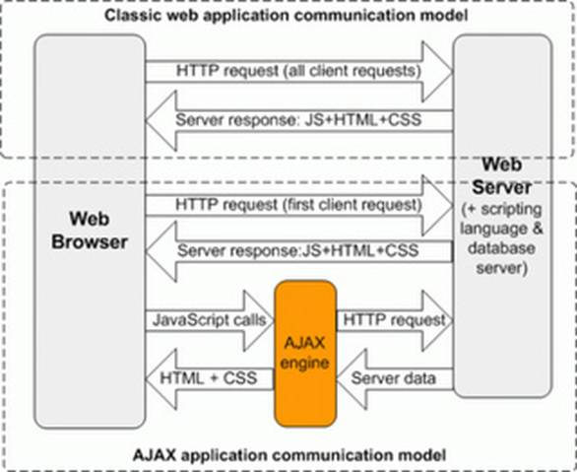
Classic vs. Ajax Application Communication Model

Slide 6
General Idea for XHR Usage
XMLHttpRequest (XHR) object is the key to Ajax technology
General idea of using XHR in Ajax:
Note: Step 4 is asynchronous, this means that we don't suspend our code for operation to complete, we pass callback function at step 2 and go further; it is called when the request changes status or completes
1. Create XHR
2. Initialize XHR properties with parameters of a request
3. Make request
4. Handle request result

Slide 7
Creating XMLHttpRequest object
All modern browsers support the XMLHttpRequest as native JS object. Syntax for creating XHR as native JS object: const xhr = new XMLHttpRequest();

Slide 8
Important Properties of XHR Object
.onreadystatechange
points to event handler that called each time when property readyState changes
.status
holds status of server response
value 200 is OK
.responseText and .responseXML
holds result of request in text or XML format
.readyState
holds current state of a request
value equal to 4 means that request is done

Slide 9
Important Methods of XHR Object
.open()
prepares the request
.setRequestHeader()
sets headers for the request
required for POST request
.abort()
aborts the request
.send()
initiates the request
optional argument provides request entity body
sets request method, request URL and synchronous flag

Slide 10
Sample Usage of responseText for JSON
In a sample below we assume that server returns encoded JSON data about client: { "name" : "John", "address": "Matrix Avenue" }
We decode JSON data into JS object clientData and use its fields to fill some placeholders in our page
01 var xhr = new XMLHttpRequest();
02 xhr.onreadystatechange = function () {
03 if (xhr.readyState === 4 && xhr.status === 200) {
04 var clientData = JSON.parse(xhr.responseText);
05 document.getElementById('clientName').innerHTML = clientData.name;
06 document.getElementById('clientAddress').innerHTML = clientData.address;
07 }
08 }
09 xhr.open('GET', 'user_data?id=1024', true);
10 xhr.send();

Slide 11
Event onreadystatechange
readyState:
Before sending request to a server we need to set a handler for a special event – onreadystatechange
As Ajax request is asynchronous, the handler for the event allows us to perform some actions based on the response from a server
The onreadystatechange event is triggered every time the readyState changes
The readyState numerical property holds the status of the XMLHttpRequest: changing from 0 to 4, see picture on the right
0 - UNSENT
1 - OPENED
2 – HEADERS_RECEIVED
3 – LOADING
4 - DONE

Slide 12
Simple onreadystatechange Event Handler
01 xhr.onreadystatechange = function () {
02 if (xhr.readyState === 4 && xhr.status === 200) {
03 document.getElementById('someDiv').innerHTML = xhr.responseText;
04 }
05 }
Comments to the sample:
We create anonymous function and assign it to onreadystatechange property of XMLHTTPRequest object instance
As our function will be called each time the property readyState changes, we need to check when value becomes equal to 4 (DONE state).
Also we have to check property status that returns status of the request. The value 200 means that result is OK, all other values mean error.
In the body of handler we replace inner HTML contents of an element with someDiv id with contents of responseText property

Slide 13
Sending Ajax Request
To send a request to a server, we use the open() and send() methods of the XMLHttpRequest object.
Method open() specifies the type of request, the URL, and if the request should be handled asynchronously or not: open(method,url,async)
method: the type of request: GET or POST
url: the address on the server to make request for
async: true (asynchronous) or false (synchronous) Note: as Ajax requests should be asynchronous, this value must be set to true
Method send() sends the request off to the server: send(string)
string: data to send, used for POST requests

Slide 14
GET Request
Sample 'GET' request:
xhr.open('GET', 'ajax_page.aspx?name=John&value=42', true);
xhr.send();
Comments:
GET is simpler and faster than POST, and can be used in most cases
Parameters should be transferred as part of URL address
Maximum length of URL address limited, that is why it can't be used for transferring volume data
GET requests may be cached by browser

Slide 15
POST Request
Sample 'POST' request:
xhr.open('POST', 'ajax_page.aspx', true);
xhr.setRequestHeader('Content-type', 'application/x-www-form-urlencoded');
xhr.send('name=John&value=42');
Comments:
POST request is not limited in size, so it might be used for transferring volume data
Parameters should be passed as argument for send() method
Method setRequestHeader() should be used to define request headers for the server to understand format of a request body

Slide 16
Server Response
To get the response from a server, use one of properties of the XMLHttpRequest object:
responseText – get the response data as string, may be used to transfer JSON data;
responseXML – get the response data as XML data.

Slide 17
Upload file to the server using standard AJAX methods
The FormData object lets you compile a set of key/value pairs to send using XMLHttpRequest. It is primarily intended for use in sending form data, but can be used independently from forms in order to transmit keyed data. The transmitted data is in the same format that the form's submit() method would use to send the data if the form's encoding type were set to multipart/form-data.

Slide 18
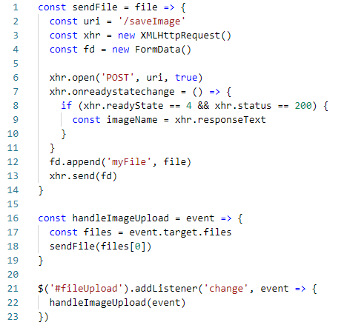

FormData example:
We have an HTML input element with type="file":
This is the frontend code. We register a change handler on the #fileUpload DOM element, and when the user chooses an image, we trigger the sendFile() function passing in the file selected.
sendFile() prepares the XHR (AJAX) request and sends the file to the server. When the server returns successfully, it will send us the image name. With that, we will do what we need to do, like updating the interface with the image.

Slide 19
Fetch

Slide 20
Fetch
JavaScript can send network requests to the server and load new information whenever is needed.
For example, we can use a network request to:
Submit an order,
Load user information,
Receive latest updates from the server,
…etc.
There are multiple ways to send a network request and get information from the server.
The fetch() method is modern and versatile, so we’ll start with it. It’s not supported by old browsers (can be polyfilled), but very well supported among the modern ones.

Slide 21

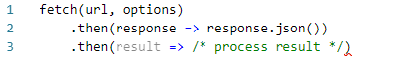
A typical fetch request consists of two await calls:
Or, without await:
Response properties:
response.status – HTTP code of the response,
response.ok – true is the status is 200-299.
response.headers – Map-like object with HTTP headers.

Slide 22
Methods to get response body:
response.text() – return the response as text,
response.json() – parse the response as JSON object,
response.formData() – return the response as FormData object (form/multipart encoding, see the next chapter),
response.blob() – return the response as Blob (binary data with type),
response.arrayBuffer() – return the response as ArrayBuffer (low-level binary data),
Fetch options so far:
method – HTTP-method,
headers – an object with request headers (not any header is allowed),
body – the data to send (request body) as string, FormData, BufferSource, Blob or UrlSearchParams object.

Slide 23
Ajax with jQuery

Slide 24
Methods of jQuery for Ajax Support
.ajax()
loads html code into some DOM element of a page
.get()
makes Ajax request by using HTTP GET method
.post()
makes Ajax request by using HTTP POST method
simplest Ajax method of a jQuery library
.getJSON()
loads JSON-encoded data from the server using HTTP GET request
supports JSONP that allows to overcome same origin policy
main Ajax method of a jQuery library
provides numerous settings
.load()

Slide 25
Method .load()
Method .load() loads html code into some DOM element of a page
Syntax: .load( url [, data] [,complete] )
url: string containing the URL to which the request is set
data: plain object or string that is sent to the server
complete: a callback function that is executes when the request completes
Sample: $('#result').load('ajax/test.html');
Method supports jQuery selectors passed after url address that determine the content to be loaded.
Sample: $('#new-projects').load('/resources/load.html #projects li');

Slide 26
Method .get()
Method .get() loads data from the server using HTTP GET request
Syntax: .get( url [, data ] [, success ] [, dataType ] )
url – a string containing the URL to which the request is sent
data - a plain object or string that is sent to the server with the request
success - a callback function that is executed if the request succeeds
dataType - the type of data expected from the server. Default: Intelligent Guess (xml, json, script, or html).
Returns: method returns jqXHR object

Slide 27
Example of .get() Method Call
Sample usage of jQuery .get() method shown in an example below:
we make GET request to some url 'example.php' passed as first argument assuming that it returns json data with fields 'name' and 'address'
as second argument we pass callback function that will add received data to the body of a document
as third argument we pass data format descriptor 'json'
additionally we call .done() method of returned jqXHR object to log successful request
01 $.get('example.php', function(data) {
02 $('body')
03 .append('Name: ' + data.name)
04 .append('Address: ' + data.address);
05 }, 'json')
06 .done(function() {
07 console.log('Request completed successfully');
08 });

Slide 28
Method .post()
Method .post() loads data from the server using HTTP POST request. Syntax is identical to shown before method .get().
Syntax: .post( url [, data ] [, success ] [, dataType ] )
url – a string containing the URL to which the request is sent
data - a plain object or string that is sent to the server with the request
success - a callback function that is executed if the request succeeds
dataType - the type of data expected from the server. Default: Intelligent Guess (xml, json, script, or html).
Returns: method returns jqXHR object

Slide 29
Method .getJSON()
Method .getJSON() loads JSON-encoded data from the server using HTTP GET request.
Syntax: . getJSON( url [, data ] [, success ] )
url – a string containing the URL to which the request is sent
data - a plain object that is sent to the server with the request
success - a callback function that is executed if the request succeeds
Returns: method returns jqXHR object
Important Note: If the URL includes the string 'callback=?' (or similar, as defined by the server-side API), the request is treated as JSONP instead. This allows to overcome same origin policy limitation of Ajax and make request to other domains

Slide 30
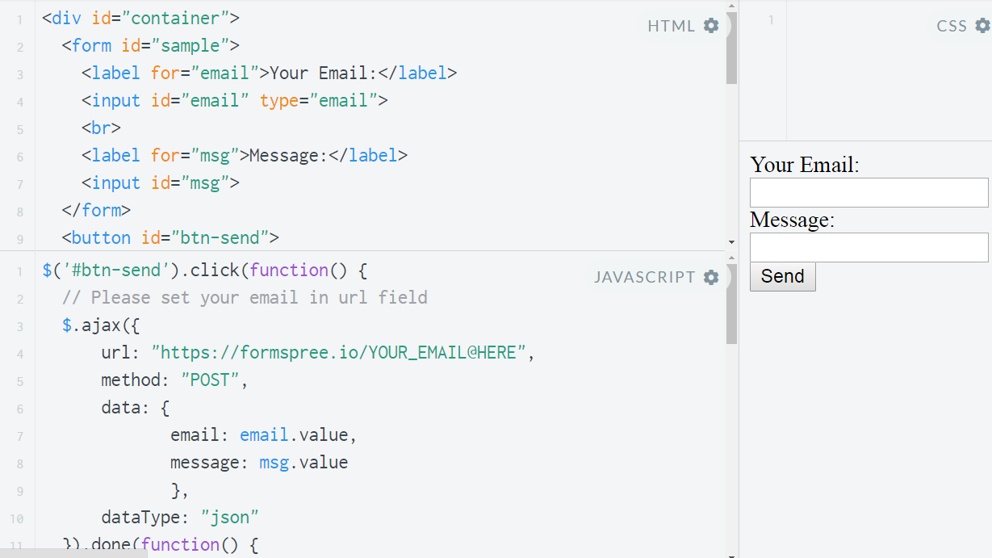
Sample Sending Form

Slide 31
USED MATERIALS
https://javascript.info/fetch
https://developer.mozilla.org/en-US/docs/Web/API/Fetch_API/Using_Fetch
https://developer.mozilla.org/en-US/docs/Web/Guide/AJAX
https://softserve.academy/

Slide 32
Thank you!

